Slide 1
Professor
Jorge Alfonso Meléndez Acuña

Slide 2
Welcome
It's important to ask:
How robust is a network?
Depending on its topology, how easy is it to attack? How vulnerable are networks?

Slide 3
Schedule
Network Science for Data Analytics
Unit 1
Introduction to Network Analysis
Unit 2
Centrality
Measures
Unit 3
Introduction to Network Models
Unit 4
Community Detection
Unit 5
Error and Attack Tolerance
Unit 6
Graph Machine Learning
Introduction to
Data Science
Basic Concepts of Graph Theory
Hubs
Communities
Vulnerability in networks
Machine Learning with Graphs
Introduction to Network Science
Small Worlds
Network Models
Deep Learning with Graphs

Slide 4
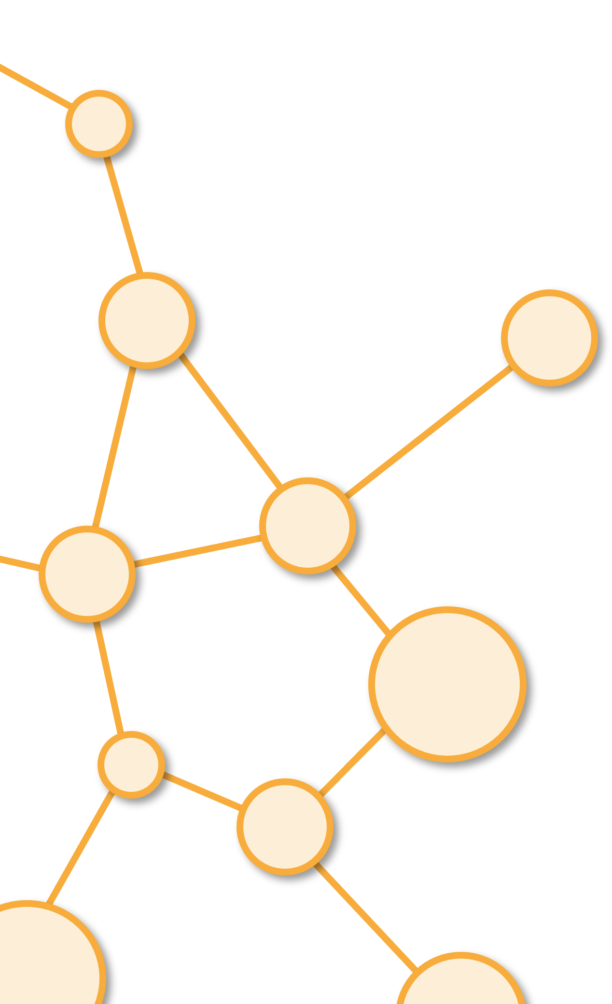
Diffusion in Networks
Unit 5

Slide 5
Outline
1. Diffusion in Networks: SIR Model
2. Simple and Complex Contagion
3. Vulnerability in Networks

Slide 6
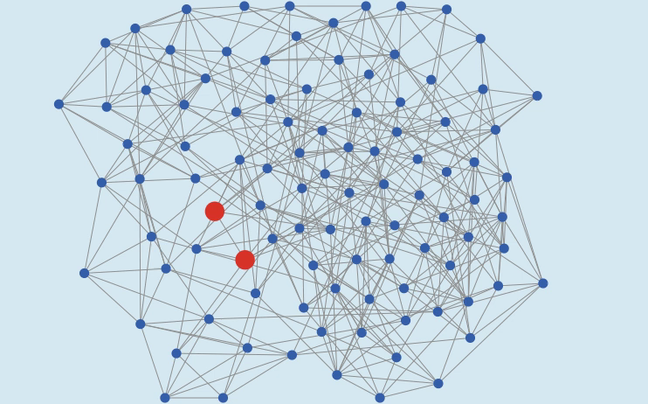
Dynamics on Networks
There are several classes of dynamical network models.
Models for “dynamics on networks”:
These models are the most natural extension of traditional dynamical systems models.
They consider how the states of components, or nodes, change over time through their interactions with other nodes that are connected to them.
Reference: Own creation, Network on NetLogo.

Slide 7
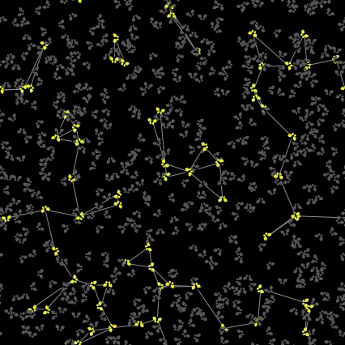

Dynamics of Networks
Models for “dynamics of networks”
These are the models that consider dynamical changes of network topology over time, for various purposes:
to understand mechanisms that bring particular network topologies,
to evaluate robustness and vulnerability of networks,
to design procedures for improving certain properties of networks, etc.
Reference: Fireflies video, Alfonso Meléndes Model.

Slide 8
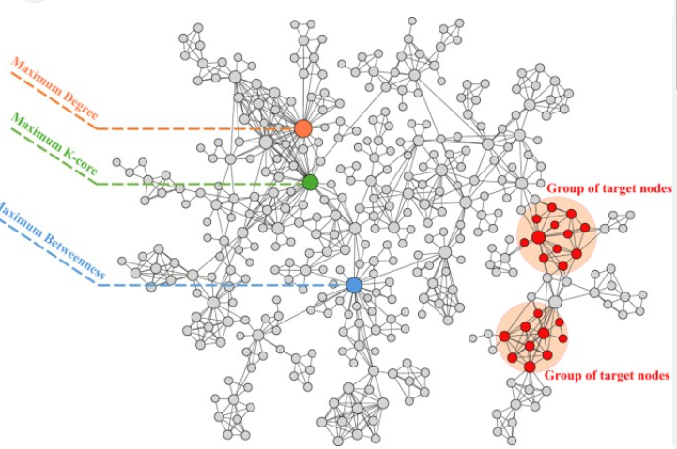
Dynamics on Networks - Examples
Disease infection on social networks, where nodes are individuals and the node states are their epidemiological states (e.g., susceptible, infected, recovered, immunized, etc.).
Reference: Spreading to localized targets in complex networks, image taken from: https://www.nature.com/articles/srep38865

Slide 9
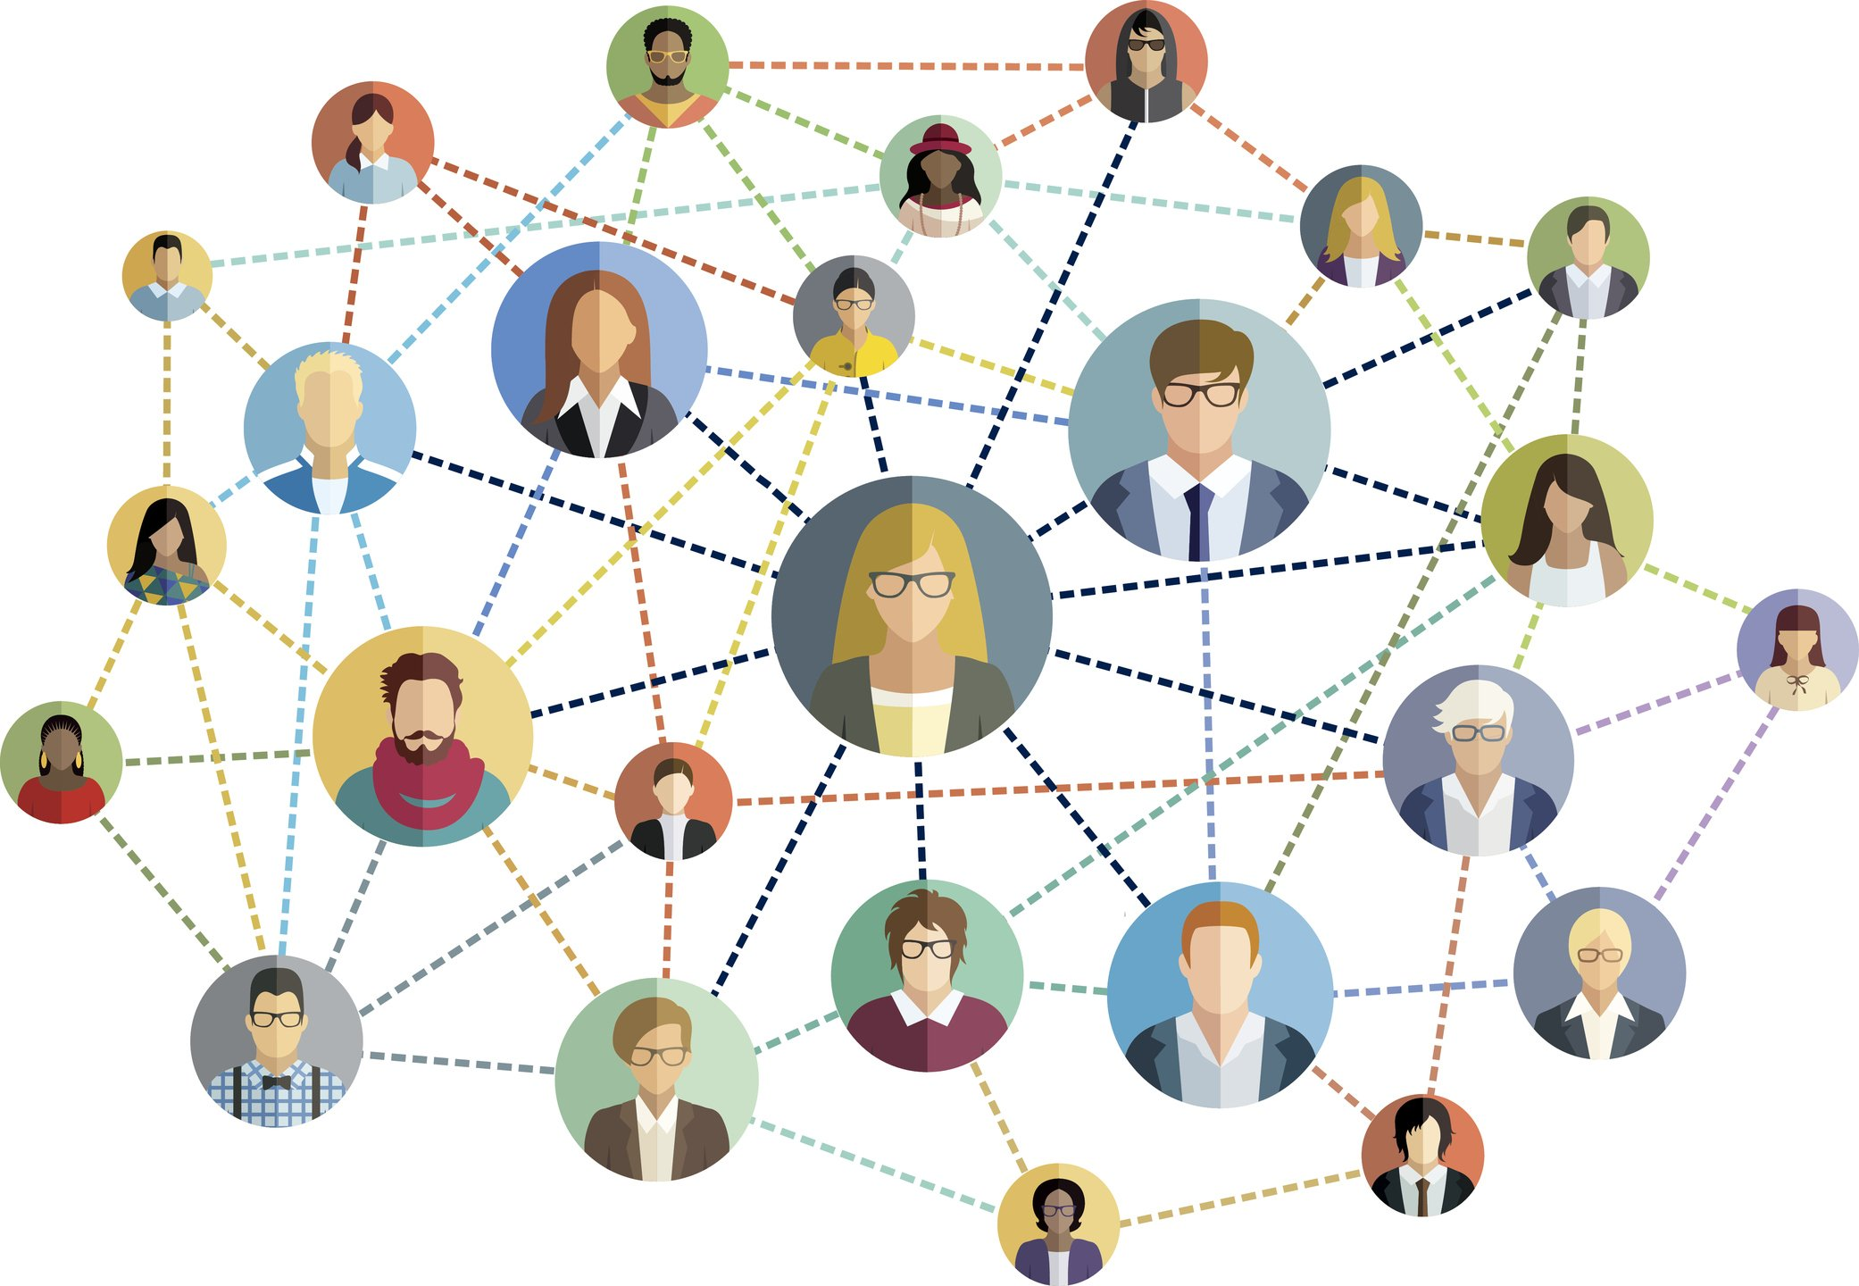
Dynamics on Networks - Examples
Information/culture propagation on organizational/social networks, where nodes are individuals or communities and the node states are their informational/cultural states.
Reference: aelitta. (2016). Red social - ilustración vectorial. - Ilustración de stock. iStock.

Slide 10
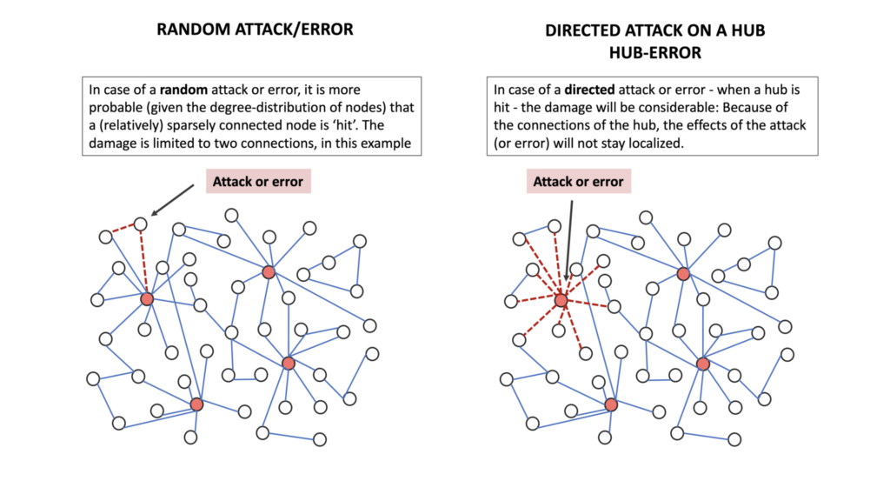
Dynamics of Networks - Example
Attack to a electrical network,
Vaccination in a human network
Reference: aelitta. (2016). Red social - ilustración vectorial. - Ilustración de stock. iStock.

Slide 11
Diffusion : Important Parameters
Seeds of the diffusion (centralities)
Type of diffusion (simple, complex,cascades)
Objectives of the diffusion (maximize diffusion, minimize, prevent)
Type of Network (small worlds, random, scale free, geometric)
Failures, attacks ( vaccination, random attacks)
A lot of literature in this area

Slide 12
¿Open Problem? (NP)
One method of viral marketing involves seeding certain consumers within a population to encourage faster adoption of the product throughout the entire population.
However, determining how many and which consumers within a particular social network should be seeded to maximize adoption is challenging.
(Wilenski, Rand Evolving Viral Marketing Strategies 2010)

Slide 13

Biological Diffusion
Epidemics
One of the reasons for the large investment of the scientific community in the study of social networks is their connection to the spread of disease.
Reference: Image taken from https://es.gizmodo.com/el-pais-que-desplazo-a-uruguay-como-el-mas-rico-de-america-latina-en-2024-2000136182

Slide 14
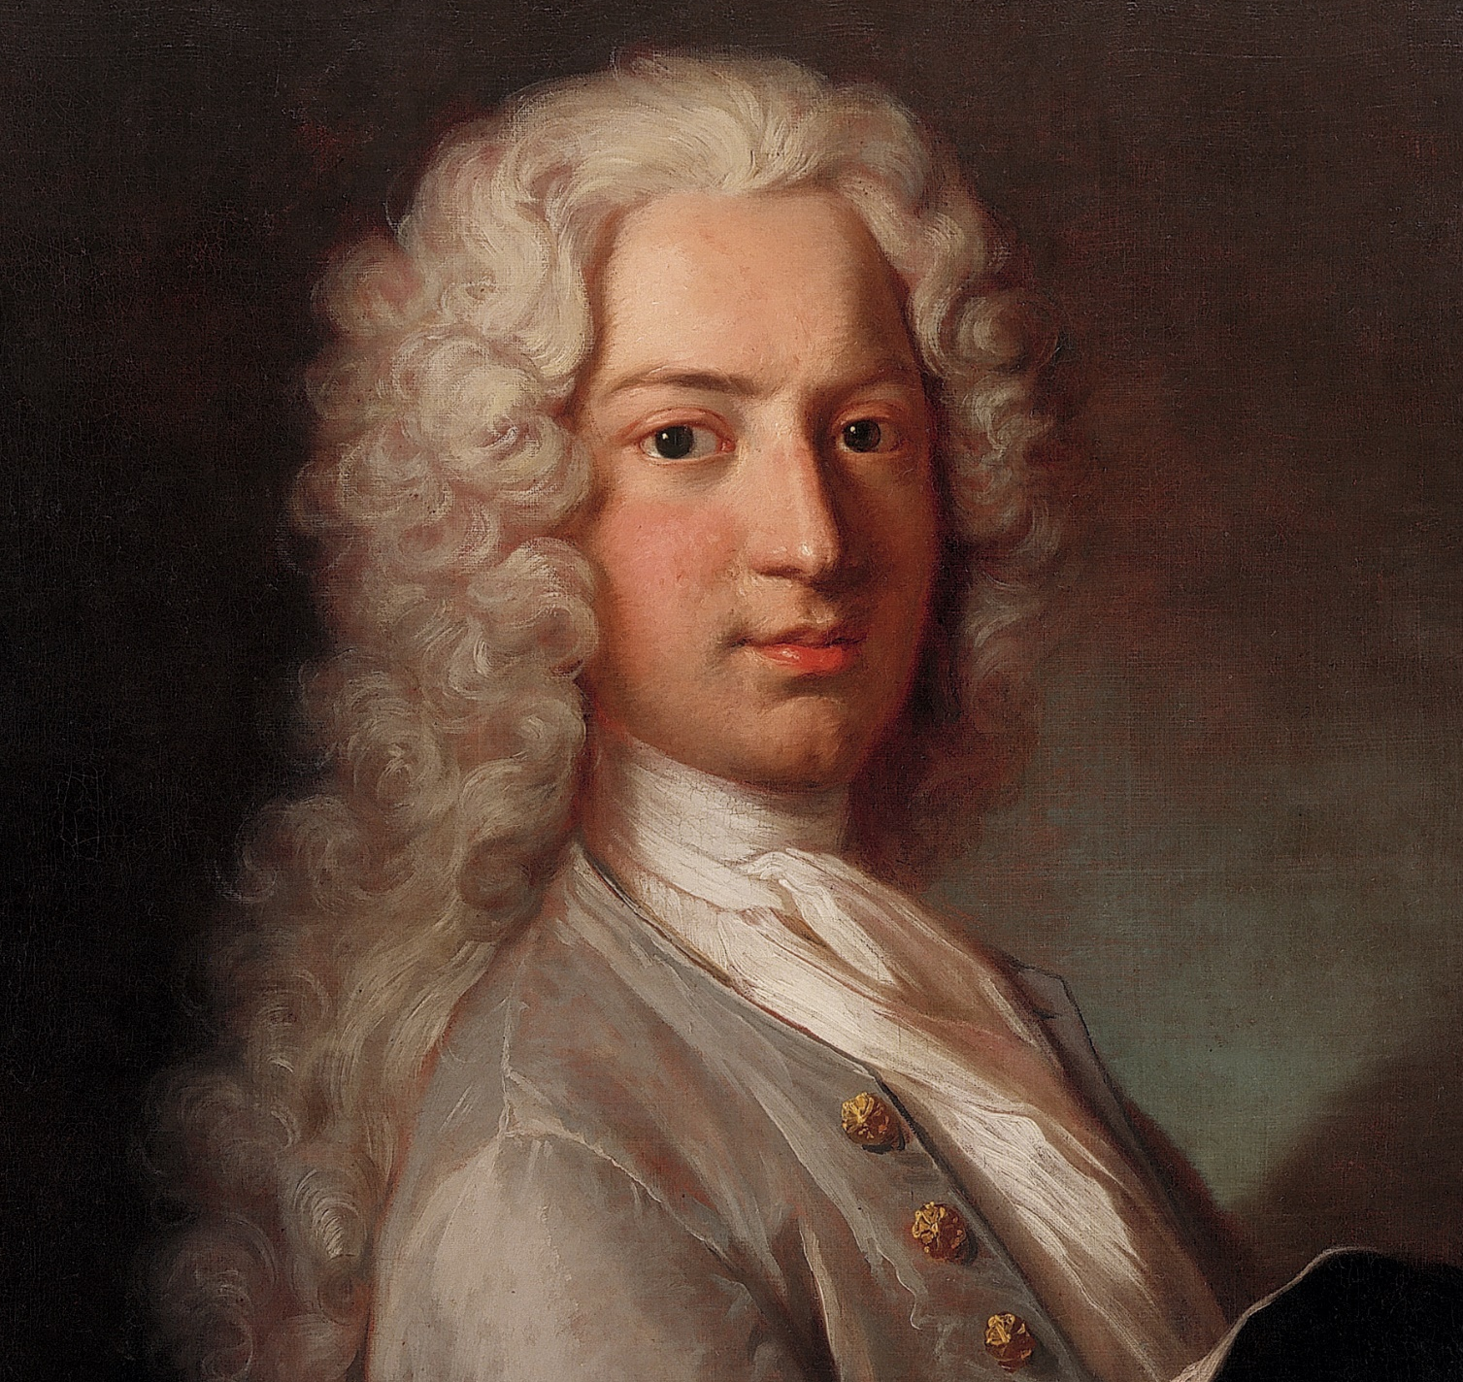
History
Since the first mathematical approach to the spread of a disease by Daniel Bernoulli (1760), epidemic models lie at the core of our understanding about infectious diseases.
The main objective of Bernoulli was to calculate the gain in life expectancy at birth if smallpox were to be eliminated as a cause of death.
Reference: Portrait of Daniel Bernoulli from Wikipedia, https://en.wikipedia.org/wiki/Daniel_Bernoulli

Slide 15
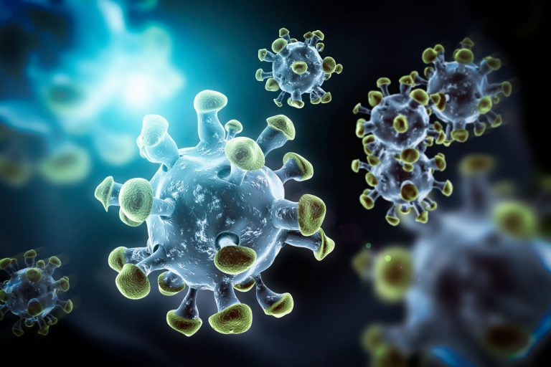
History
As experimenting in-vivo epidemics is not a viable option, modeling approaches have been the main resort to compare and test theories.
Reference: Amaviael. Coronavirus VIruses Ilustración Conceptual. Dreamstime, https://es.dreamstime.com/coronavirus-viruses-ilustraci%C3%B3n-conceptual-virus-como-el-y-otros-este-podr%C3%ADa-ser-peligroso-o-mortal-sars-image173002141

Slide 16
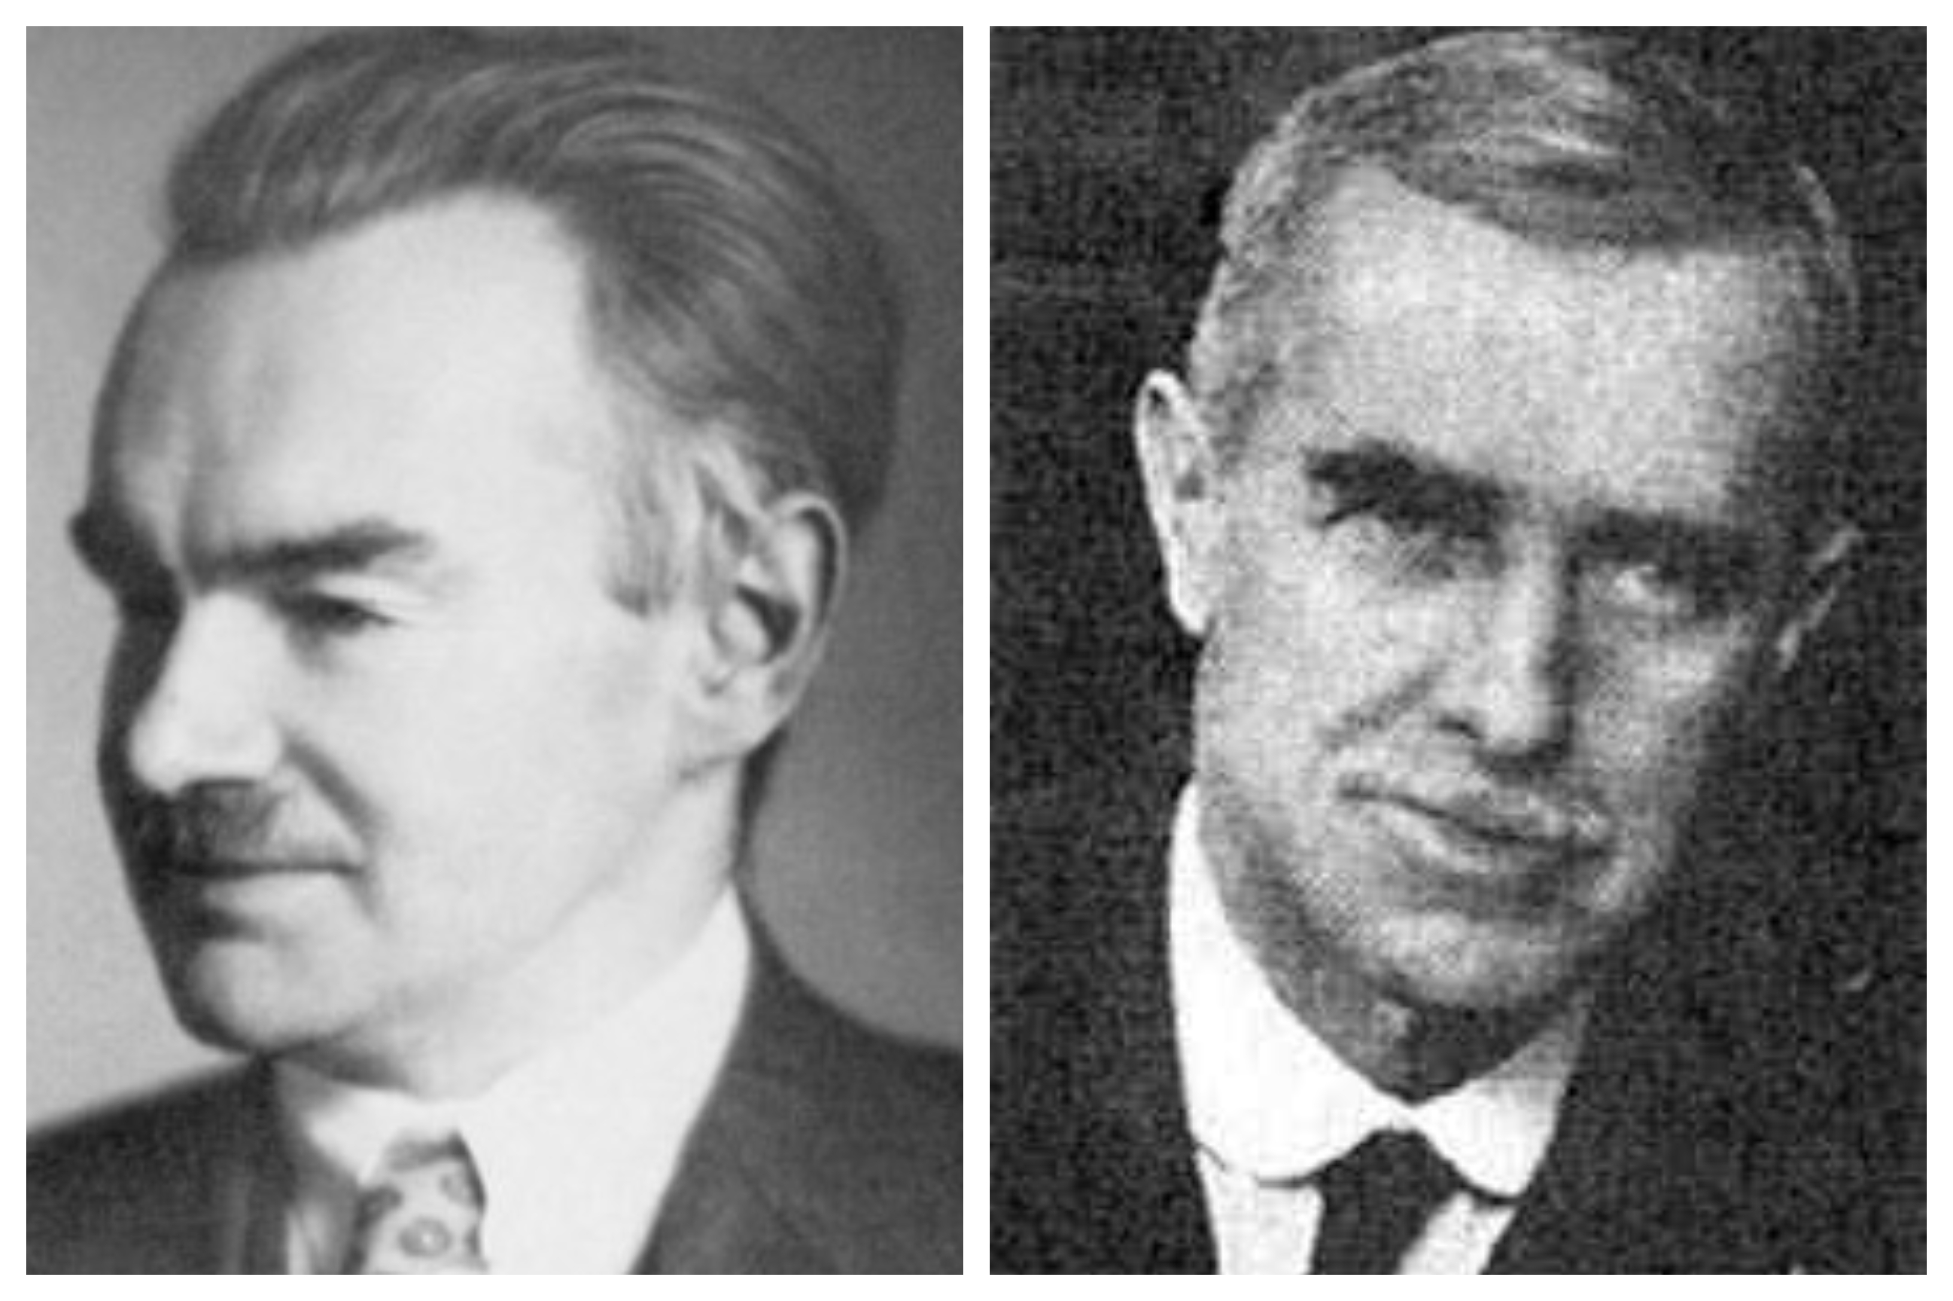
History
The acclaimed work of Kermack and McKendrick (1927), defining the modern mathematical modeling of infectious diseases has evolved along the years in an impressive body of work…
Reference: Kermack-eta-A.-G.-McKendrick, imagen taken from: https://culturacientifica.com/2020/08/24/el-modelo-sir-un-enfoque-matematico-de-la-propagacion-de-infecciones/kermack-eta-a-g-mckendrick/

Slide 17

History
…whose culmination is well represented by the remarkable summary by Anderson and May (1992).
Reference: Anderson, R.M. and May, R.M. (1992) Infectious Diseases of Humans: Dynamics and Control.

Slide 18

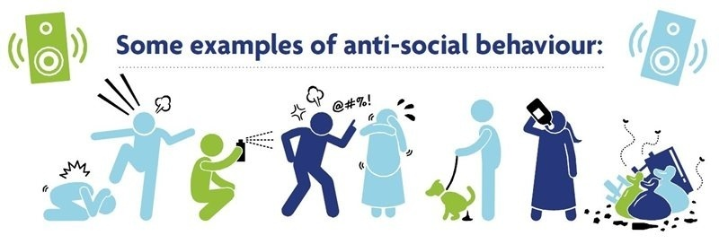
History
At the same time, the epidemic modeling metaphor has been introduced to describe a wide array of different phenomena….
Reference: 1. Image taken from https://marriagefamilyblog.wordpress.com/2017/11/06/social-interactionism-theory/ 2. Some examples of anti-social behavior. Imagen taken from https://www.facebook.com/photo/?fbid=2879526448962177&set=a.1572396643008504

Slide 19
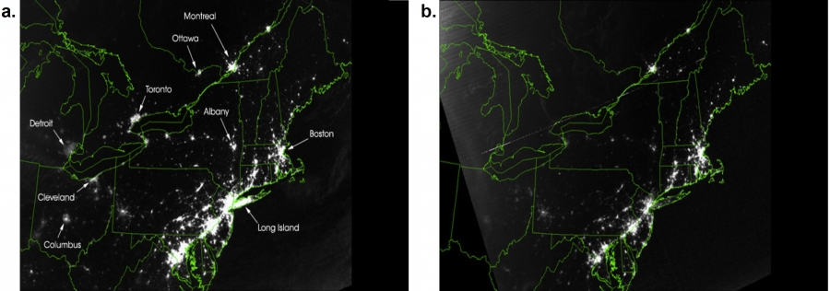
History
How black-outs spread on a nationwide scale…
Satellite image on Northeast United States on August 13th, 2003,at 9:29pm (EDT), 20 hours before the 2003 blackout.
The same as above, but 5 hours after the blackout.
Reference: Albert-László Barabási. Network Science. Chapter 1. Image 1.1 Example of a blackout. https://networksciencebook.com/chapter/1

Slide 20
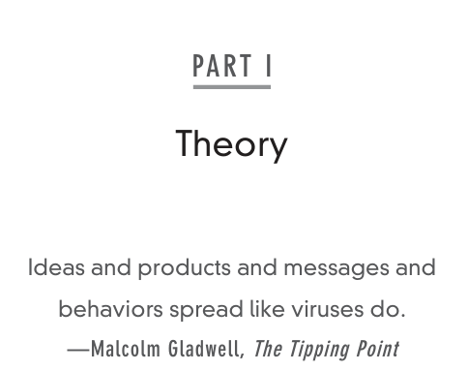
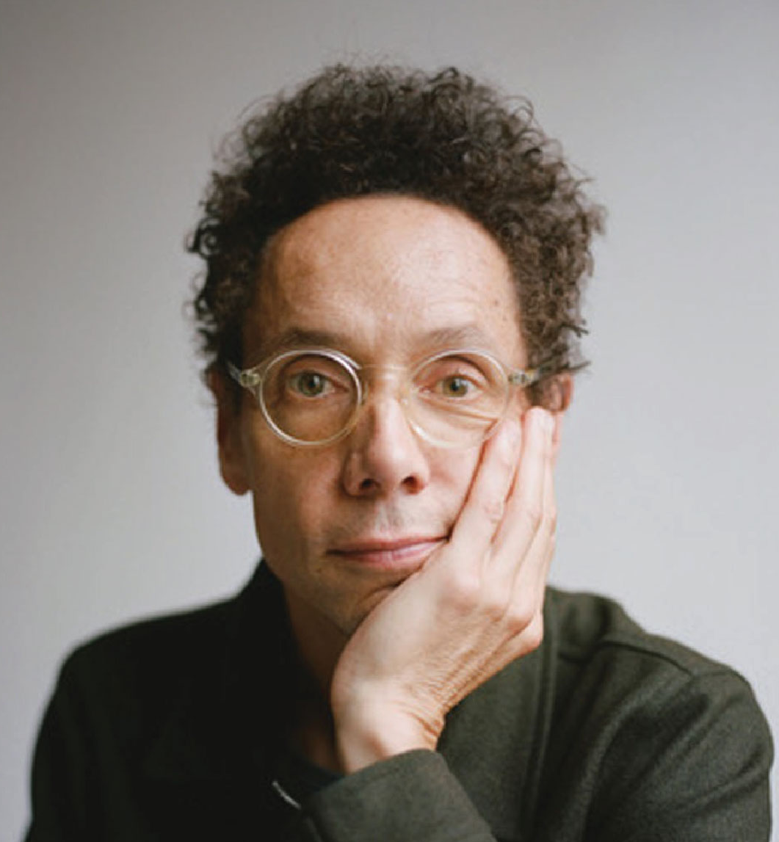
Claim
Year : 2000
… the spread of information, cultural norms and social behavior can be conceptually modeled as a contagion process.
Reference: Picture of Malcolm Gladwell, taken from https://pgsignal.com/2022/06/07/malcolm-gladwell-on-building-trust/

Slide 21

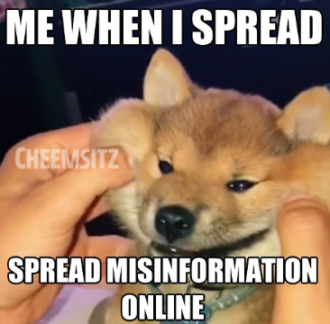
Claim
… or how efficiently memes can spread on social networks are all phenomena whose mathematical description relies on models akin to classic epidemic models (Vespignani, 2012)
Reference: 2. Meme taken from: https://knowyourmeme.com/photos/2386375-spreading-misinformation

Slide 22
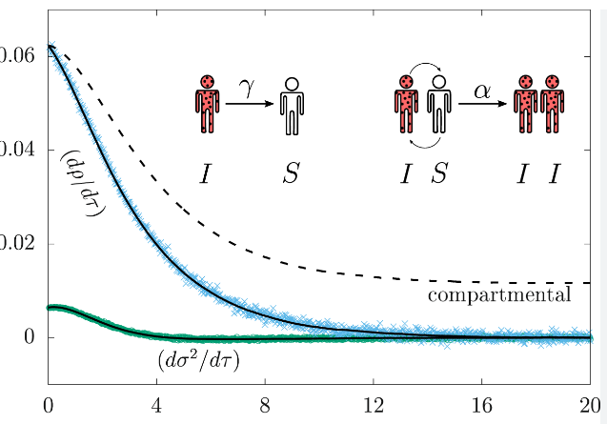
Summary
Epidemic modeling is a research field that crosses different disciplines and has developed a wide variety of approaches ranging from simple explanatory models to very elaborate stochastic methods.
Reference: Michele Coscia. The Atlas for the Aspiring Network Scientist. https://www.networkatlas.eu/files/sna_book.pdf

Slide 23
Today

Slide 24

Today
In recent years, we are witnessing a second golden age in epidemic modeling …
Reference: The Golden Age. Imagen taken from: https://www.readingvine.com/passages/the-golden-age/

Slide 25
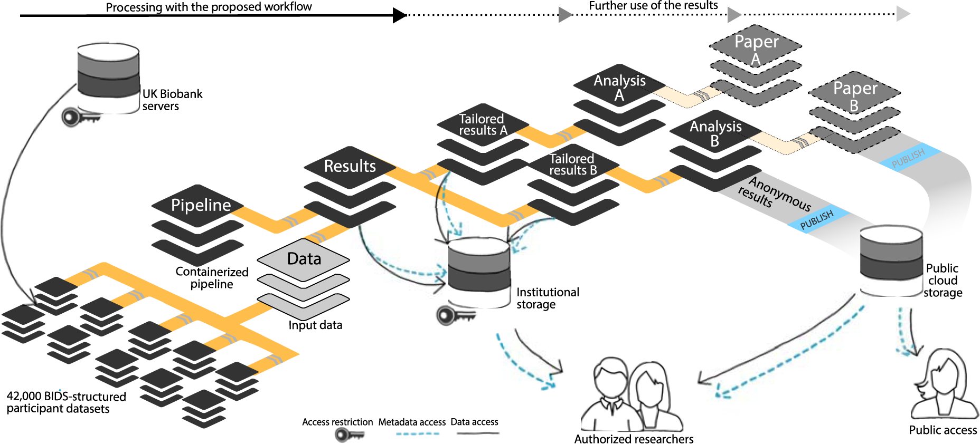
Today
… real-world accuracy of the models used in epidemiology has been considerably improved by the integration of large-scale datasets
Reference: Wagner, A.S., Waite, L.K., Wierzba, M. et al. (2022). FAIRly big: A framework for computationally reproducible processing of large-scale data. Figure 3. https://www.nature.com/articles/s41597-022-01163-2/figures/3

Slide 26
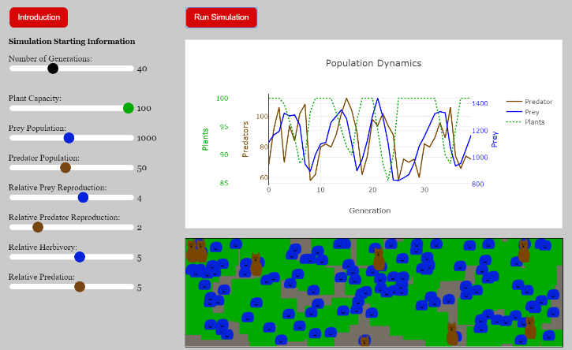
Today
and the explicit simulation of entire populations down
to the scale of single individuals
Reference: Population Dynamics, image taken from: https://www.biologysimulations.com/population-dynamics

Slide 27
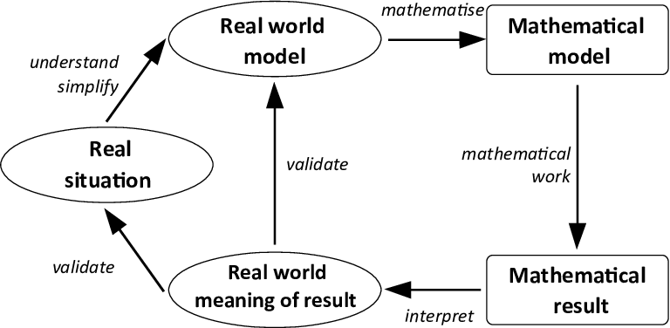
Today
Mathematical models have evolved into microsimulation models that can be computationally implemented by keeping track of billions of individuals.
Reference: Modelling cycle (Kaiser and Stender 2013, p. 279). https://www.researchgate.net/figure/Modelling-cycle-Kaiser-and-Stender-2013-p-279_fig20_333153492

Slide 28
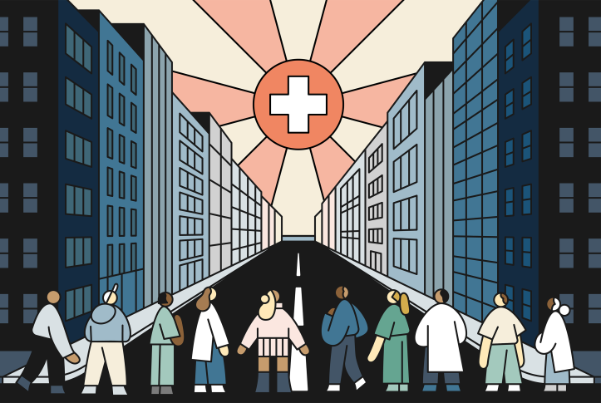
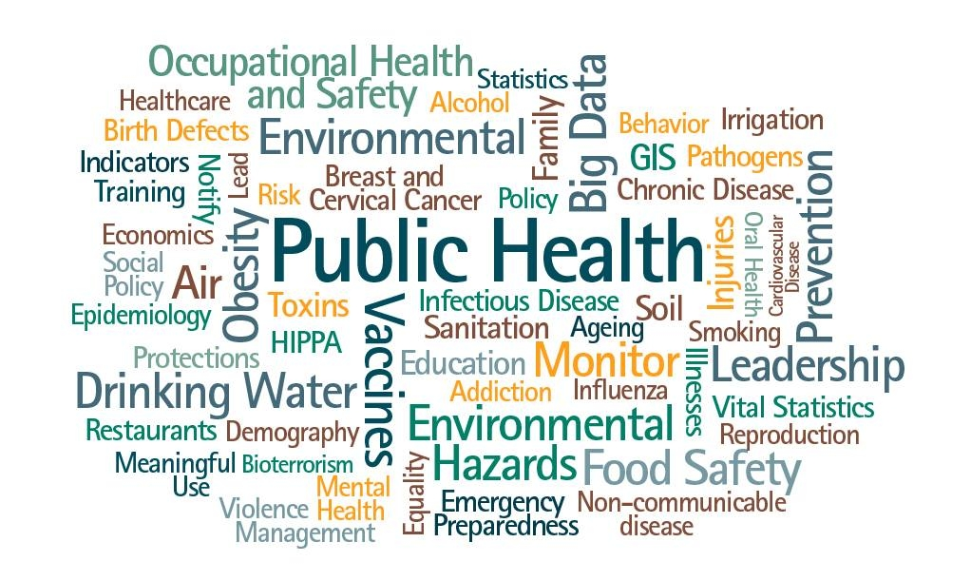
Today
These models have gained importance in the public health domain, especially in infectious disease epidemiology, by providing quantitative analyses in support of policy-making processes
Reference: 1. Illustration by Rose Wong, taken from https://www.commonwealthfund.org/publications/podcast/2022/jun/strong-public-health-system-depends-on-making-invisible-visible. 2. Public Health, imagen taken from https://www.facebook.com/photo/?fbid=911255981003944&set=a.532563495539863&locale=ps_AF

Slide 29
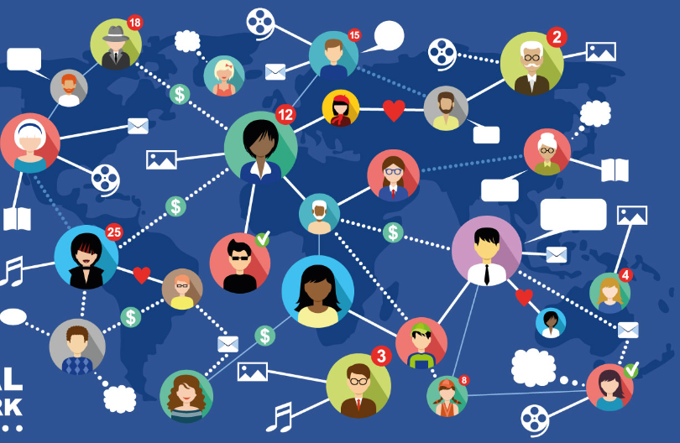
Today
At the core of all data-driven modeling approaches lies the structure of human interactions, mobility and contacts patterns that finds its best representation in the form of networks
Reference: Social Networks, Internet Communication, image taken from https://www.shutterstock.com/es/image-vector/social-networks-internet-communication-vector-224504248

Slide 30
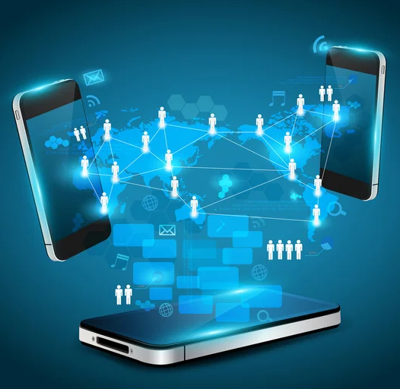
Today
The pervasive use of mobile and Wifi technologies in our daily life is changing the way we can measure human interactions and mobility network patterns for millions of individuals at once.
Reference: Mobile phones technology business concept, Creative network information process diagram. Image taken from https://www.everypixel.com/image-12481499202145626443

Slide 31
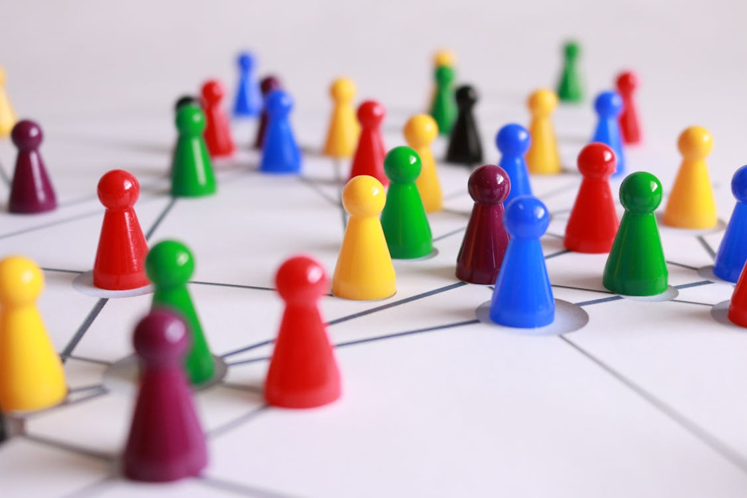
Epidemics
Infectious diseases are diffused through a population by means of the interactions between individuals. We will show how network structure affects the spread of a virus.
Reference: Pixabay. Fotografía De Cerca De Conos De Plástico Amarillo, Verde, Rojo Y Marrón Sobre Una Superficie Revestida De Blanco. https://www.pexels.com/es-es/foto/fotografia-de-cerca-de-conos-de-plastico-amarillo-verde-rojo-y-marron-sobre-una-superficie-revestida-de-blanco-163064/

Slide 32
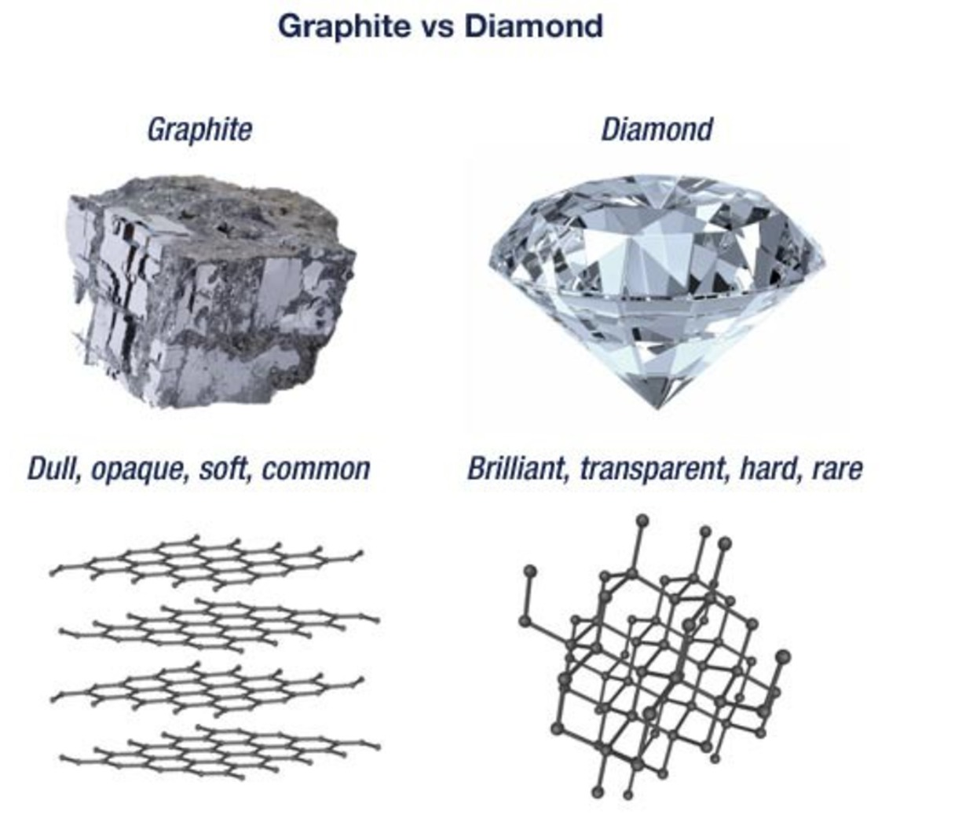
Structure Defines Behaviour

Slide 33
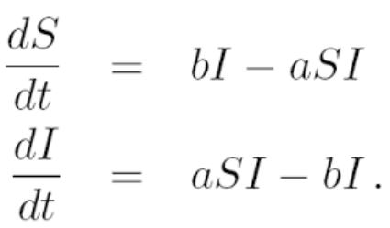
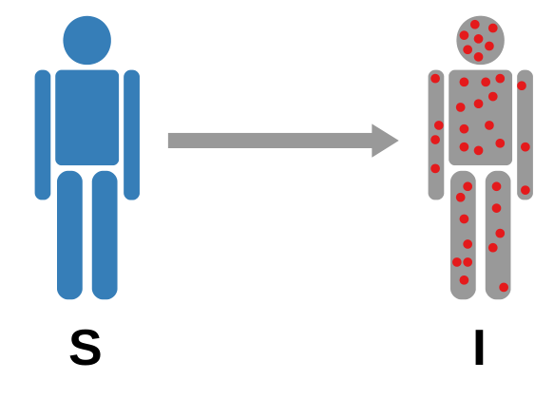
SI Model
S: Susceptible
I: Infected
Reference: Michele Coscia. The Atlas for the Aspiring Network Scientist. https://www.networkatlas.eu/files/sna_book.pdf

Slide 34
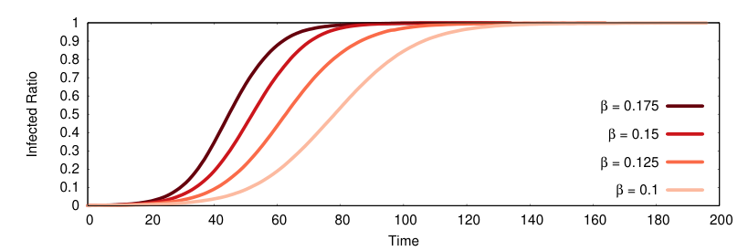

SI Model
True Love is Forever:
Just Like Herpes
Link to SI Model
Reference: Michele Coscia. The Atlas for the Aspiring Network Scientist. https://www.networkatlas.eu/files/sna_book.pdf

Slide 35
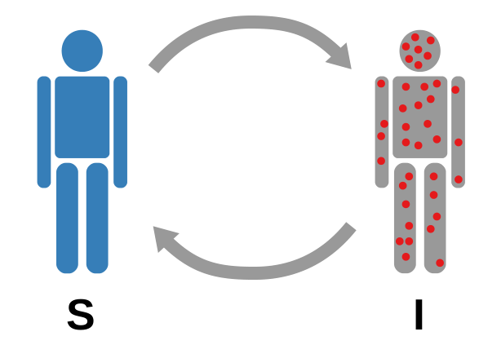
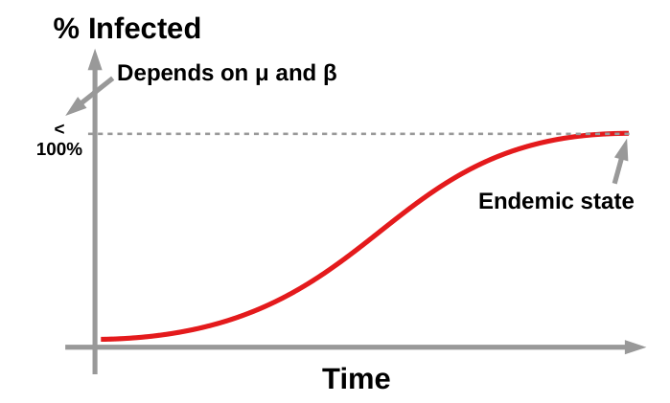
SIS Model
Flu comes and goes
Link to SIS Model
Reference: Michele Coscia. The Atlas for the Aspiring Network Scientist. https://www.networkatlas.eu/files/sna_book.pdf

Slide 36
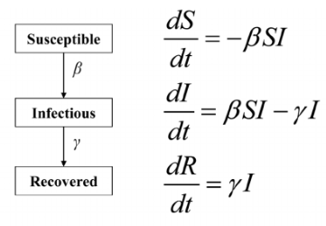
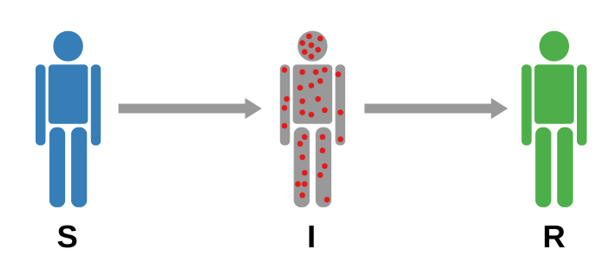
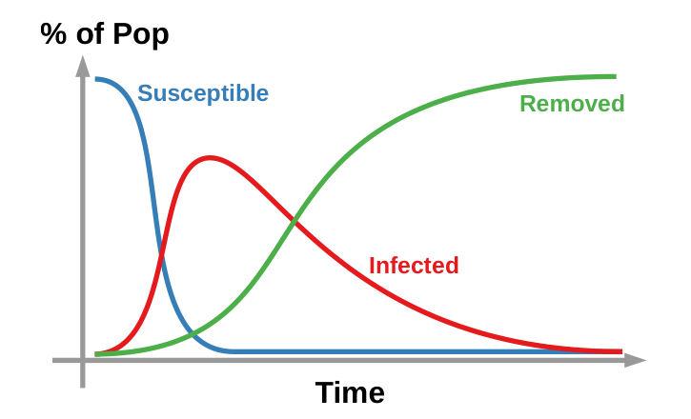
SIR Model
A classic way to describe the diffusion of a disease in a population is to distinguish three components:
Susceptible, Infected and Recovered.
Recovered
Reference: Michele Coscia. The Atlas for the Aspiring Network Scientist. https://www.networkatlas.eu/files/sna_book.pdf

Slide 37
SIR Model
Recovered
Susceptible
Infected
Recovered
Link to SIR Model
Reference: Michele Coscia. The Atlas for the Aspiring Network Scientist. https://www.networkatlas.eu/files/sna_book.pdf

Slide 38
Simuladores

Slide 39
Simuladores Difusión
Difusión Tres Modelos de Red
Difusión SIR Tres Modelos
Difusión - Experimentos

Slide 40
Simuladores Vulnerabilidad
Vulnerabilidad-Componentes-TresModelos
Vulnerabilidad-APL-TresModelos
Difusión – Ataque-Completo

Slide 41
Good bye
We hope that the information in this study material has contributed to the understanding of the most important concepts of this topic.
We invite you to continue reviewing all the educational materials available on the platform.

Slide 42
References
Albert-László Barabási. Network Science. https://networksciencebook.com/
Anderson, R.M. and May, R.M. (1992) Infectious Diseases of Humans: Dynamics and Control.
Michele Coscia. The Atlas for the Aspiring Network Scientist. https://www.networkatlas.eu/files/sna_book.pdf
Wagner, A.S., Waite, L.K., Wierzba, M. et al. (2022). FAIRly big: A framework for computationally reproducible processing of large-scale data. https://www.nature.com/articles/s41597-022-01163-2

Slide 43
Image copyright
aelitta. (2016). Red social - ilustración vectorial. - Ilustración de stock. iStock. Ilustración de Red Social Ilustración Vectorial y más Vectores Libres de Derechos de Conexión - Conexión, Red informática, Redes sociales – iStock
Albert-László Barabási. Network Science. Chapter 1. Image 1.1 Example of a blackout. https://networksciencebook.com/chapter/1
Amaviael. Coronavirus VIruses Ilustración Conceptual. Dreamstime, https://es.dreamstime.com/coronavirus-viruses-ilustraci%C3%B3n-conceptual-virus-como-el-y-otros-este-podr%C3%ADa-ser-peligroso-o-mortal-sars-image173002141
Illustration by Rose Wong, taken from https://www.commonwealthfund.org/publications/podcast/2022/jun/strong-public-health-system-depends-on-making-invisible-visible
Image taken from https://es.gizmodo.com/el-pais-que-desplazo-a-uruguay-como-el-mas-rico-de-america-latina-en-2024-2000136182
Image taken from https://marriagefamilyblog.wordpress.com/2017/11/06/social-interactionism-theory/
Kermack-eta-A.-G.-McKendrick, imagen taken from: https://culturacientifica.com/2020/08/24/el-modelo-sir-un-enfoque-matematico-de-la-propagacion-de-infecciones/kermack-eta-a-g-mckendrick/
Meme taken from: https://knowyourmeme.com/photos/2386375-spreading-misinformation
Michele Coscia. The Atlas for the Aspiring Network Scientist. https://www.networkatlas.eu/files/sna_book.pdf
Mobile phones technology business concept, Creative network information process diagram. Image taken from https://www.everypixel.com/image-12481499202145626443

Slide 44
Image copyright
Modelling cycle (Kaiser and Stender 2013, p. 279). https://www.researchgate.net/figure/Modelling-cycle-Kaiser-and-Stender-2013-p-279_fig20_333153492
Picture of Malcolm Gladwell, taken from https://pgsignal.com/2022/06/07/malcolm-gladwell-on-building-trust/
Pixabay. Fotografía De Cerca De Conos De Plástico Amarillo, Verde, Rojo Y Marrón Sobre Una Superficie Revestida De Blanco. https://www.pexels.com/es-es/foto/fotografia-de-cerca-de-conos-de-plastico-amarillo-verde-rojo-y-marron-sobre-una-superficie-revestida-de-blanco-163064/
Population Dynamics, image taken from: https://www.biologysimulations.com/population-dynamics
Portrait of Daniel Bernoulli from Wikipedia, https://en.wikipedia.org/wiki/Daniel_Bernoulli
Social Networks, Internet Communication, image taken from https://www.shutterstock.com/es/image-vector/social-networks-internet-communication-vector-224504248
Some examples of anti-social behavior. Imagen taken from https://www.facebook.com/photo/?fbid=2879526448962177&set=a.1572396643008504
Spreading to localized targets in complex networks, image taken from: https://www.nature.com/articles/srep38865
The Golden Age. Imagen taken from: https://www.readingvine.com/passages/the-golden-age/
Wagner, A.S., Waite, L.K., Wierzba, M. et al. (2022). FAIRly big: A framework for computationally reproducible processing of large-scale data. Figure 3. https://www.nature.com/articles/s41597-022-01163-2/figures/3

Slide 45
Credits
Subject Matter Expert
Instructional Designer
Jorge Alfonso Meléndez Acuña
Angela Maria Arboleda Restrepo
Subject Matter Expert
Graphic Designer
Luis Fernando Niño Vásquez
Tania Valentina Flórez Rincón
First version
Date: April 2025

